Slide 1
Unit 04: Deep Learning Research
Linear Factor Models, Autoencoders, representation learning, Deep Generative Models.

Slide 2
Linear Factor Model
In the context of deep learning, a linear factor model can be understood as a simpler version of a model that tries to predict outcomes (such as an output layer in a neural network) based on various factors (features).
While deep learning models are generally much more complex and nonlinear, linear models can still be a foundational concept that helps us understand certain layers, particularly in the early stages or in simpler models like a linear regression layer in a neural network.
For example, You are training a neural network to predict the price of a house based on several features like square footage, number of bedrooms, neighborhood, etc.

Slide 3

Input Layer: You have multiple input features (factors) like square footage (F1​), number of bedrooms (F2), and neighborhood type (F3​).
Model Structure (One Layer):
The neural network tries to predict the price of the house RpriceR_{\text{price}}Rprice​ using these factors. In a simple linear layer, the output can be modeled as:
Here:
R_{price} the predicted house price. α is the bias term (intercept).
β1,β2,β3​ are the weights corresponding to the features square footage, bedrooms, and neighborhood type.
F1, F2, F3 are the input features.
ϵ represents the noise or error (like the residuals in regression)
Training: The neural network will adjust the weights (β1,β2,β3) during training to minimize the error between the predicted house prices and the actual prices from the training.

Slide 4
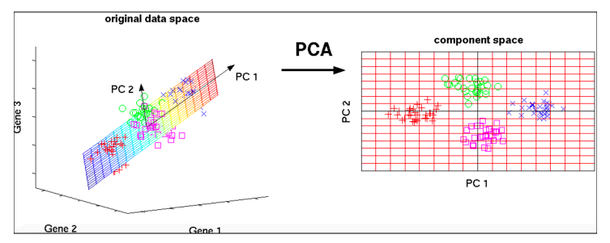
Probabilistic PCA (PPCA)
Principal components capture the most variation in a dataset
PCA deals with the curse of dimensionality by capturing the essence of data into a few principal components.

Slide 5
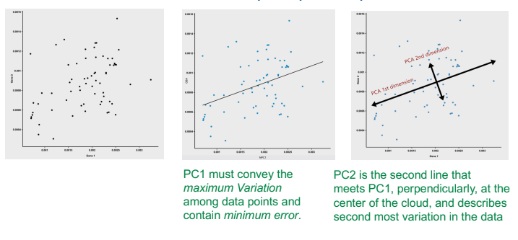
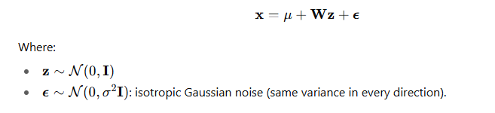
Example and Formula for PCA

Slide 6
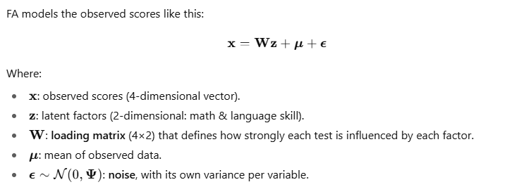
Confirmatory Factor Analysis
Factor analysis is a technique for identifying which underlying factors are measured by a (much larger) number of observed variables. Such “underlying factors” are difficult to measure , e.g., IQ, depression or extraversion.
More flexible, often used in psychology and social sciences. Useful when modeling correlated noise or measurement errors specific to each feature.

Slide 7
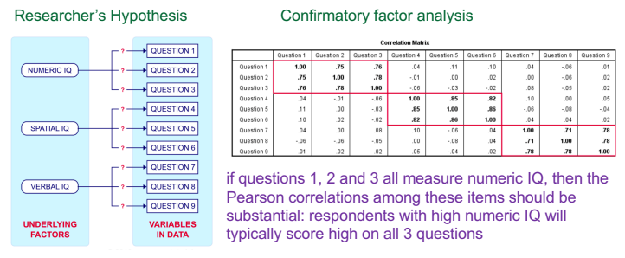

Slide 8
PCA vs. Factor Analysis
• Both are data reduction techniques
• Both involve choosing components or factors
• Fundamental difference between them:
– PCA is a linear combination of variables
– Factor Analysis is a measurement model of a latent variable
• PCA is a more basic version of Factor Analysis

Slide 9
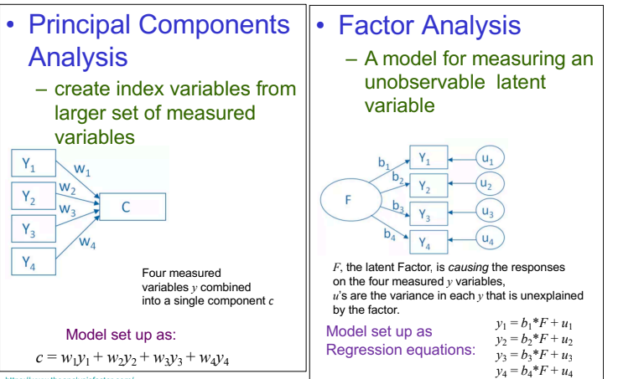

Slide 10
Independent Component Analysis
Independent Component Analysis (ICA) is a computational method for separating a multivariate signal into additive, independent components — often used in signal processing, neuroscience (EEG/MEG), and financial time series.
Example: The Cocktail Party Problem
You're at a party with several people speaking simultaneously (different sources). You have multiple microphones (observed signals), each capturing a mixture of all the voices. ICA tries to recover each individual speaker’s voice — without knowing what they said or how the microphones were positioned.

Slide 11
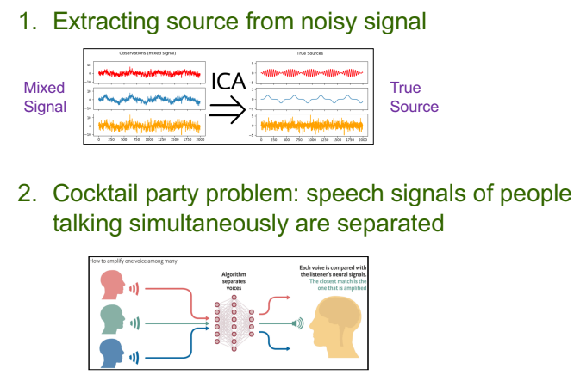

Slide 12
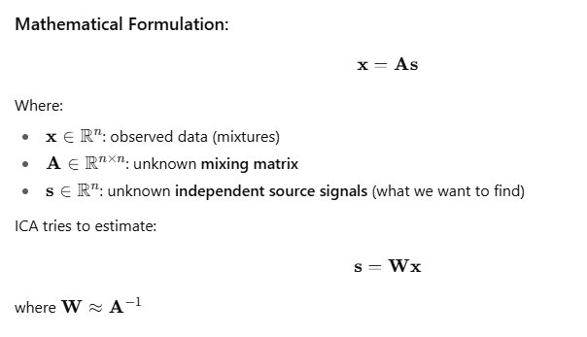

Slide 13
Slow Feature Analysis
It is a Linear factor model
• Uses information from time signals to learn invariant features
• Motivation: Slowness principle
– Important characteristics change slowly compared to individual measurements that make up a scene.
• Computer vision example shown next

Slide 14
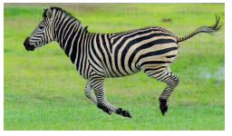
SFA in computer vision
Individual pixels can change very rapidly
• Ex: zebra moves from right to left
– Pixels change rapidly from black to white to black
– Feature indicating whether zebra is in image changes slowly
• Regularize model to learn features that change slowly with time

Slide 15

Slowness Principle
Can apply slowness principle to any model trained with gradient descent
• Slowness principle is introduced by adding a term to the cost function of the form.
– where f is feature extractor to be regularized
– λ is the strength of the slowness regularization term
– L is a loss function measuring the distance between
f (x(t)) and f (x(t+1))
• Common choice of L is the mean squared difference

Slide 16

Sparse Coding
• A linear factor model
• Studied as unsupervised feature learning and extraction
• Terminology
– Sparse Coding refers to inferring the values of h in the model
– Sparse modeling refers to process of designing and learning the model
– But sparse coding often refers to both
It uses linear decoder plus noise to obtain reconstruction of x as specified by
Sparse coding models typically assume that the linear factors have Gaussian noise with isotropic precision beta.

Slide 17
Linear Factor Models
Deep Learning Lecture on Linear Factor Models
https://cedar.buffalo.edu/~srihari/
Reference Questions:
What is linear factor analysis? Explain its graphical representation and special cases.
What is PCA?
Explain the two types of factor analysis- Confirmatory Factor Analysis and Exploratory Factor Analysis
Discuss ICA with an example.
COmpare PCA with ICA
Compare PCA with linear factor
What do you mean by slow factor analysis? Explain its significance in computer vision.
Write a short note on: Sparse coding and Manifold Interpretation of PCA

Slide 18
Autoencoders
What is autoencoders? Explain with an example.
What are the application of autoencoder?
How Autoencoders differ from General Data Compression
Explain autoencoders with a sample code.
What does an autoencoder learn? Explain with the help of autoencoder architecture.
List and explain the Two Autoencoder Training Methods.
What is Variational Autoencoder? Explain with an example.
Explain in depth about sparse autoencoder.
Write a short note on denoising autoencoders.

Slide 19
Representation learning
What is representation learning? Explain with the help of suitable examples (XOR and 2-spiral)
What is Supervised Feedforward Learning?
Compare Semi-supervised and multi-task learning.
What is unsupervised learning? Give a suitable Deep Learning based example.
What is transfer learning? Explain how it relates to representation learning in the context of DL.
What is domain adaptation? Explain how it relates to transfer learning in the context of DL.
Explain in detail one-shot learning and zero-shot learning.

Slide 20
Deep Generative Models
What are geep generative models? What is the significance of deep gen models? Or why deep gen models is used?
What are the types of deep gen models?

